Slide 1
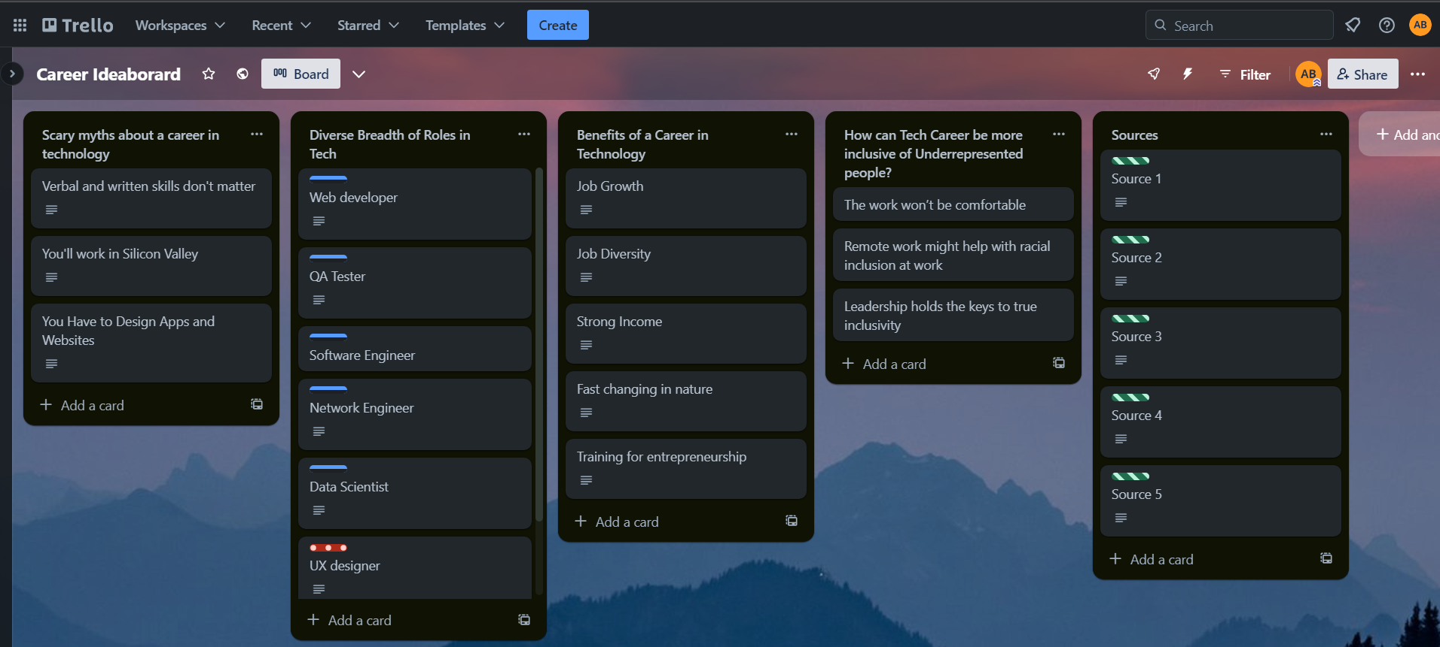
Career Ideation done using Trello -

Slide 2
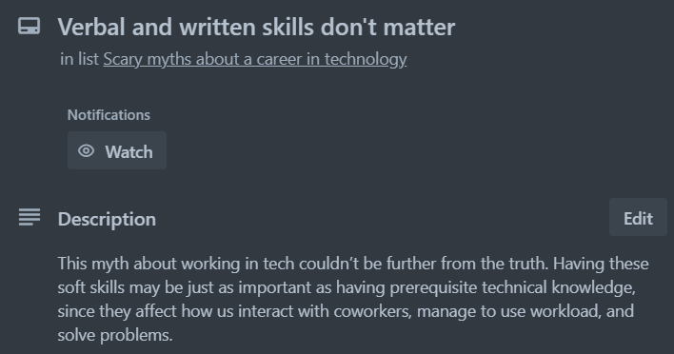

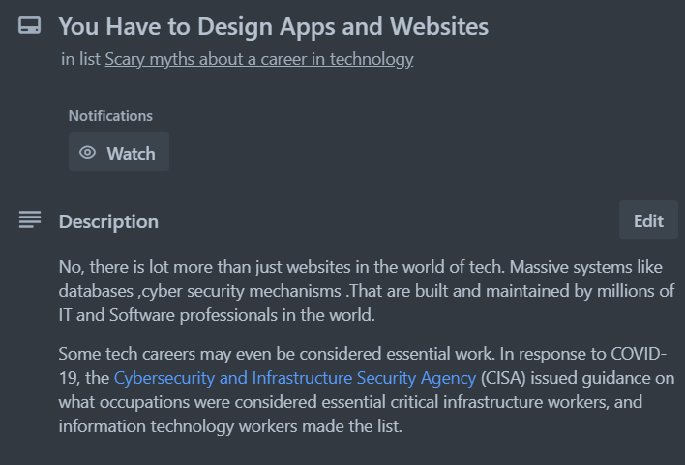
Scary Myths about a career in technology -

Slide 3
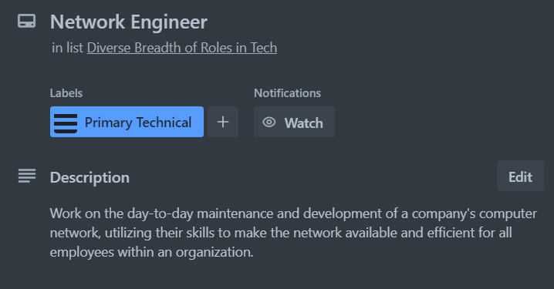

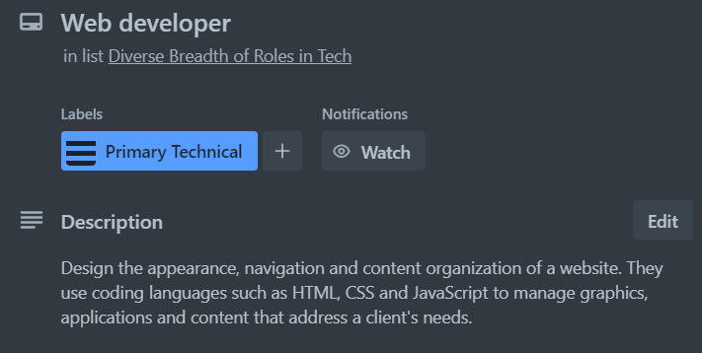
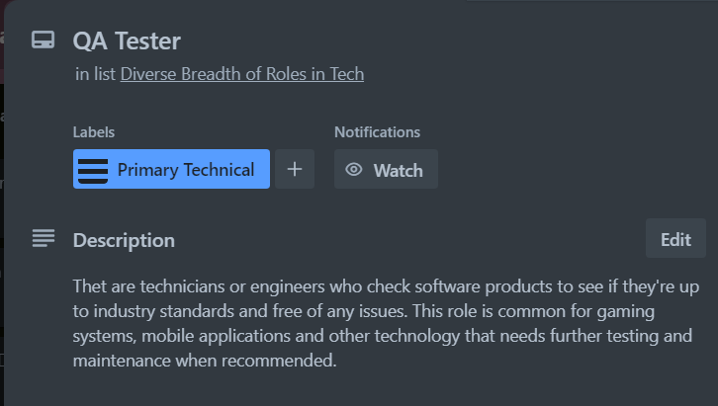
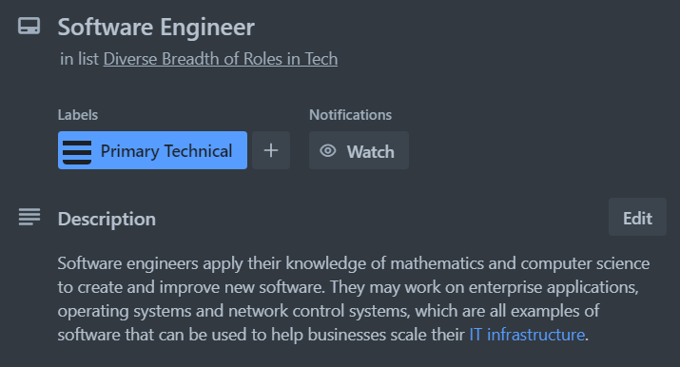
Diverse Breadth of Roles in Tech -

Slide 4
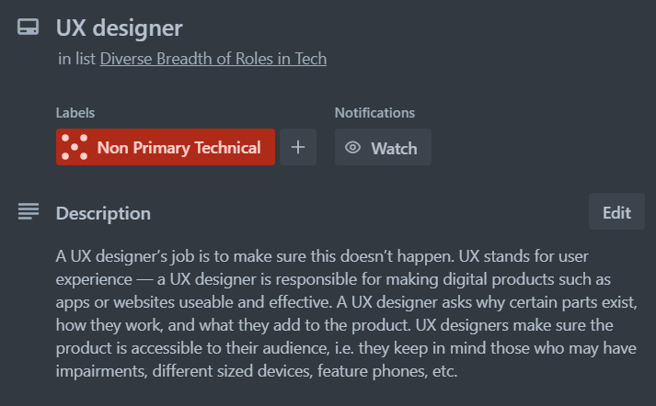
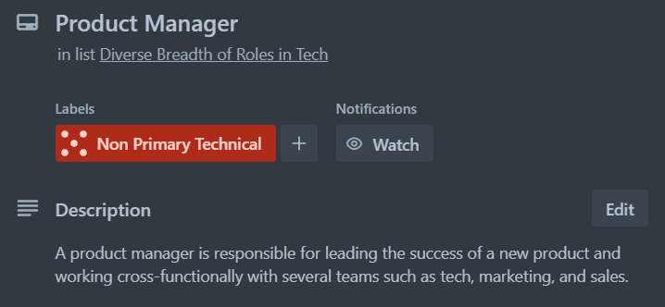
Diverse Breadth of Roles in Tech -

Slide 5
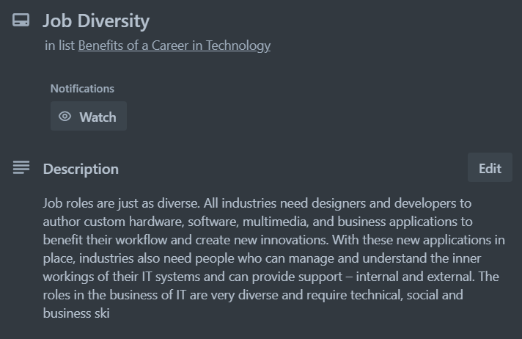




Benefits of a Career in technology -

Slide 6


Source -
https://medium.com/23codestreet/tech-career-guide-non-technical-roles-in-tech-c036475ec147
21 Different Types of IT Careers To Explore | Indeed.com
https://www.purdueglobal.edu/blog/information-technology/myths-about-working-in-tech/
Why Should I Consider an IT Career? - IT-oLogy
How to make the tech industry more inclusive

